Slide 1
COST and the Western Balkans

Slide 2
Overview
Partners from the Western Balkans have been involved in COST Actions since the founding of the COST Programme in 1971
Researchers and innovators from the region participate in all of the 250 running COST Actions
Almost 300 Western Balkans-based researchers are active in the leadership of COST Actions
Over the last 3 years, researchers in the region made a total of 240 000 connections through Action networking activities

Slide 3
Participation in COST Actions from the Western Balkans 2021-2023
* This designation is without prejudice to positions on status and is in line with UNSCR 1244 and the ICJ opinion on the Kosovo declaration of independence.

Slide 4
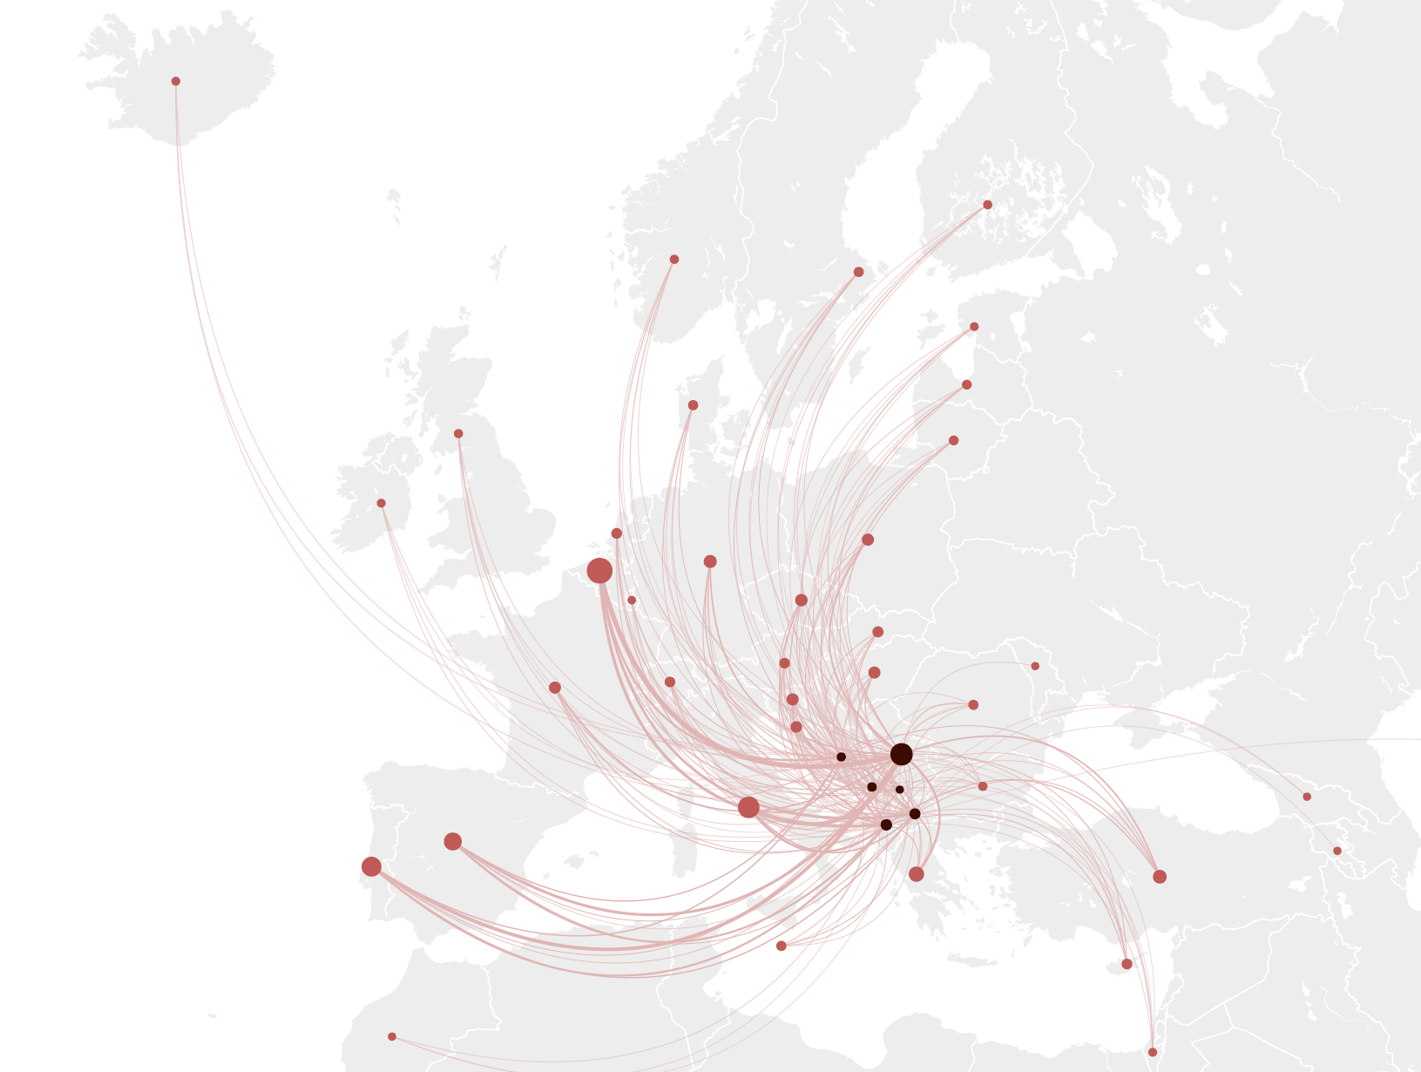
COST Action Mobility of Researchers and Innovators from the Western Balkans
COST Action Mobility of Researchers and Innovators from the Western Balkans, 2021-2023
Western Balkans Other COST members
Number of participants scale
10 100 500 1000

Slide 5
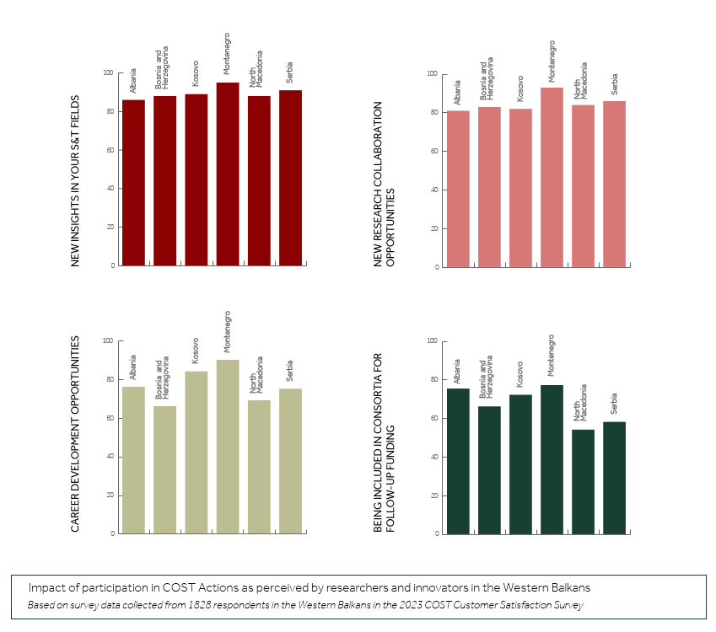
Impact of participation in COST Actions as perceived by researchers and innovators in
the Western Balkans

Slide 6
